Slide 1




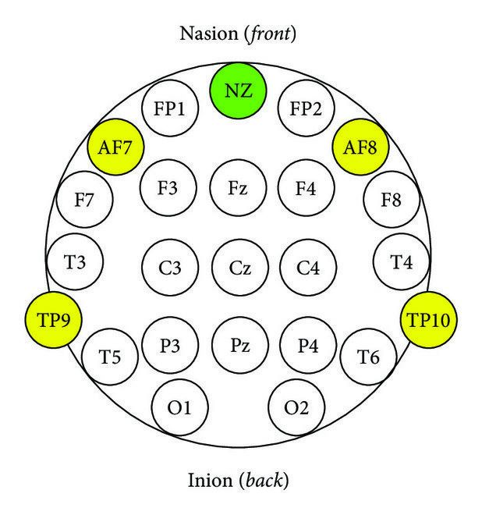
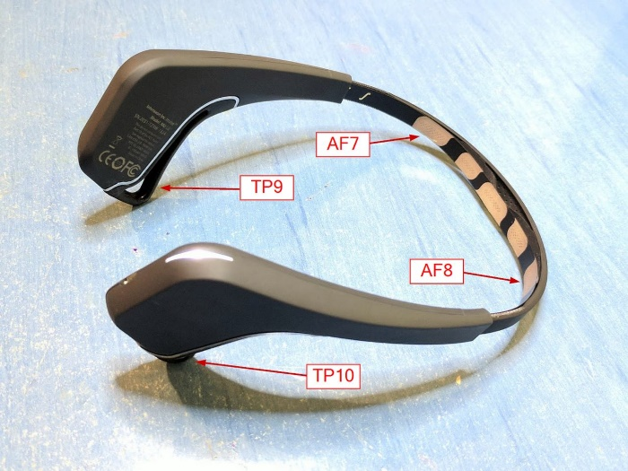
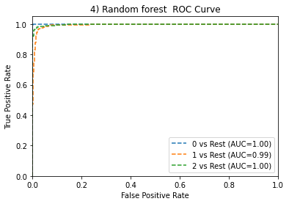
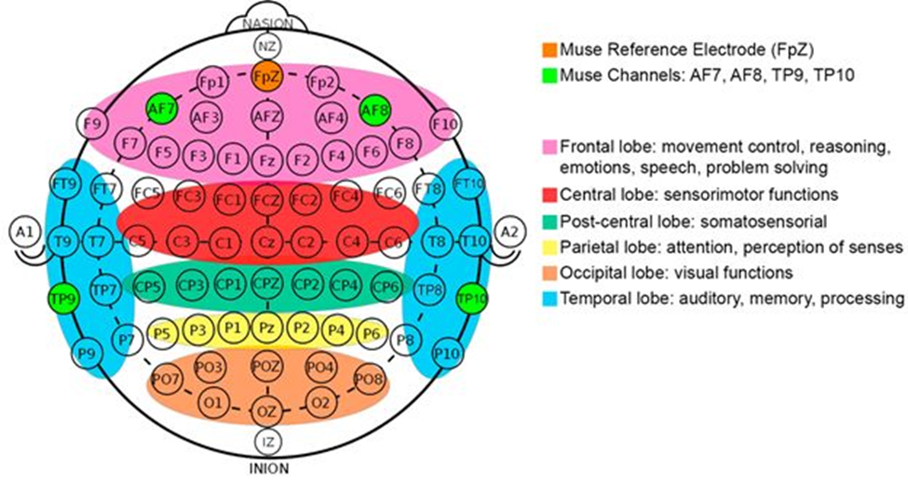
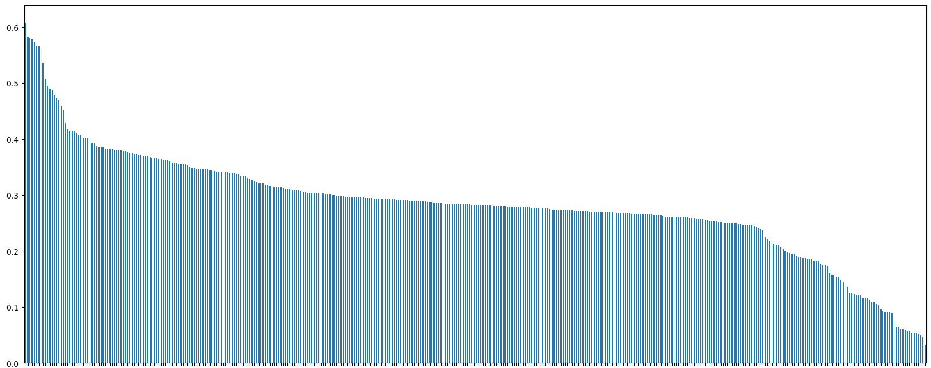
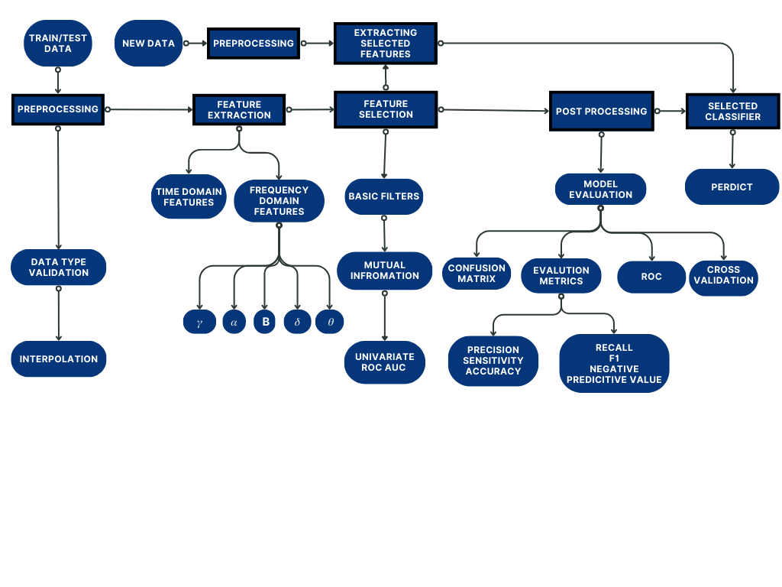
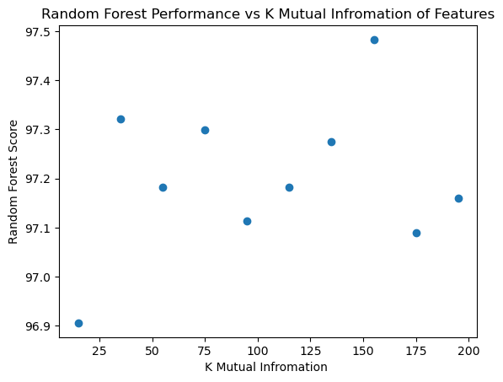
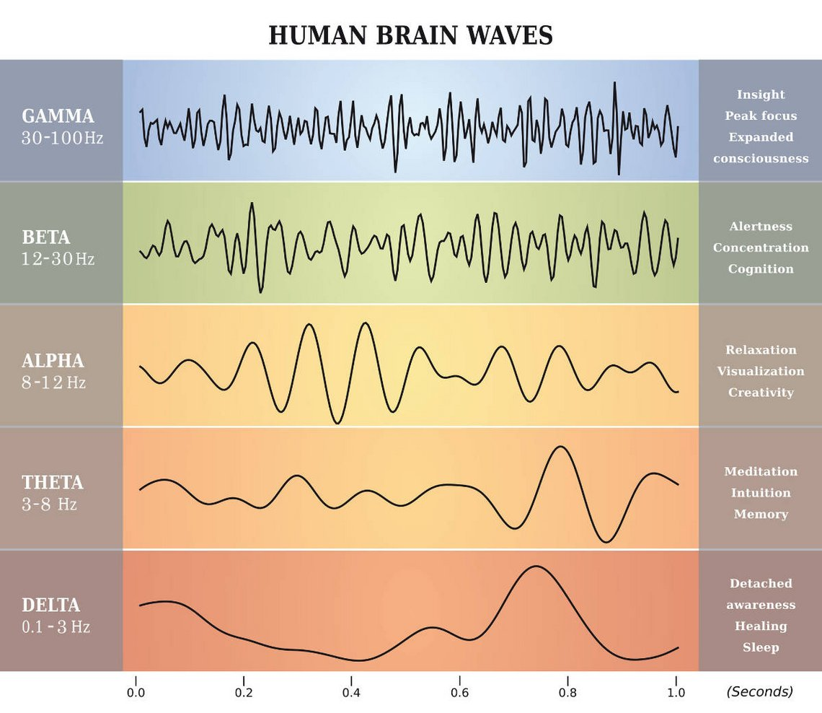
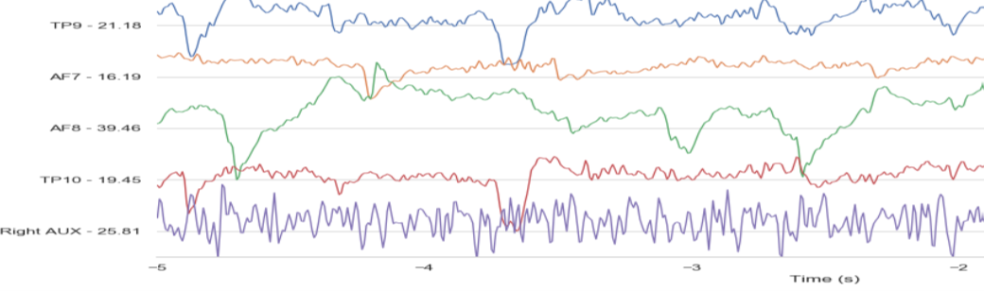
Mental State Classification using EEG
Official intelligence
Introduction
Feature Selection
Machine Learning Algorithm
Automatic detection of mental states has potential applications in healthcare, education, neuroscience, and robotics. Accurate real-time detection can provide valuable insights into cognitive and emotional processes. Mental state classification can diagnose mental health conditions, assess engagement and attention levels, study brain function, and improve human-robot interaction. Although EEG devices detect these signals, most EEG recording systems are expensive medical devices. However, some affordable EEG recording systems, such as the Muse Headband, are available for use in consumer markets.
The dataset used in this study was collected using the Muse Headband, which has four EEG sensors (TP9, AF7, AF8, TP10) placed on the forehead and behind the ears.
Analyzing EEG data can be challenging due to the high dimensionality of the features. Feature selection is a crucial step in EEG analysis, as it helps to identify the most relevant features that contribute to the classification in order to improve the performance of a machine learning model.
Filter methods are a type of feature selection method that rank features based on their individual association with the target variable. This makes them less computationally expensive than wrapper methods, which evaluate the performance of a model on all possible subsets of features.
In this study, we used filter methods to select features from an EEG dataset of 450 features. We evaluated different filter methods: Variance threshold, mutual information, and univariate ROC AUC. We found most effective combination of these filters for selecting features, reducing the number of features from 450 to 35 which reduces the model complexity without reducing the model performance.
The reduced feature set was then used to train a machine learning model to classify EEG signals into different classes. The model achieved an accuracy of 97.6%, which is comparable to the accuracy of models trained on the full feature set. This suggests that feature selection can be used to improve the performance of machine learning models without increasing the computational cost.
This study aimed to predict brain status from EEG signals using machine learning.
> Objective: To predict brain status from EEG signals using machine learning.
> Data Preparation: Categorical encoding was applied to convert the relaxed, neutral, and concentrating classes into numeric classes of 0, 1, and 2, respectively.
> Models: Naive Bayes, Support Vector Machine, Decision Tree, Random Forest, and KNN were selected and evaluated.
> Evaluation Techniques: Confusion matrix, performance metrics, ROC curves, and cross-validation were used to evaluate model performance.
> Results: The Random Forest model had the best performance, with an accuracy of 97.6% and an AUC of 1. The study highlights the importance of using ordered categorical encoding and evaluating model performance using various techniques.
Future Testing: Muse EEG data will be used with selected features extracted from segmented windows of the four channels to predict mental state.
Block diagram
Preprocessing
Sorted best Mutual Information features
After we made some observations about the timestamps of each dataset, we noticed some inconsistencies in the sampling periods (especially subject b - relaxed - 2)
In order to solve this issue, we interpolated the datasets with sampling frequency 200Hz
.
Feature Extraction
Selected Features
Conclusion
The features used to classify mental states are computed within a specific time window.
Each window has a duration of 1 second with a 0.5-second overlap between consecutive windows.
The total features summed up to 450 feature.
Features extracted:
Statistical Features
Shannon Entropy
log-energy entropy
Power Spectral Density (Mean, Max, Min)
Spectral Entropy
Spectral Edge Frequency (SEF)
Peak Frequency
For brain waves extract {𝛼, β, 𝜃, 𝛿, 𝛾} using band filter:
Statistical Features
Phase synchronization
This study aimed to classify three mental states (relaxing, neutral, and concentrating) using EEG data from the Muse headband. After feature extraction, machine learning models were trained and tested using 10-fold cross-validation, including SVM, KNN, decision tree, random forest, and naive Bayes, with the Random Forest model achieving the highest accuracy of 97.6%. The random forest model's robustness, ability to handle high-dimensional data, and resistance to overfitting contributed to its superior performance.
Our study aimed to improve the accuracy of mental state classification using EEG data by selecting more effective features for each frequency band and using suitable feature selection techniques.
In comparison to a previous study that reported an accuracy of 87.16%, our methodology achieved a significantly higher accuracy of 97.6%. The selected features included power spectral density, spectral entropy, spectral edge frequency, spectral peak frequency, and phase synchronization. mental states and populations.
Our findings suggest that our approach has the potential to enhance the accuracy of mental state classification using EEG data, which could have important implications for various applications such as mental health monitoring and brain-computer interfaces.
TABLE TO SHOW ACCURACY OF TRAINED MODELS WITH DIFFERENT FEATURES
Dataset | Model Accuracy %
 | Naive Bayes | SVM | Decision tree | Random forest | KNN
All Data | 77.7 | 78.7 | 96.1 | 97.5 | 86.5
Basic Filter | 77.5 | 78.7 | 96.3 | 97.5 | 86.5
Basic Filter + Uncorrelated | 74.8 | 58.6 | 93.7 | 96.3 | 85.8
Basic Filter + Mutual information (k = 35) | 80 | 78.7 | 96.4 | 97.3 | 90.6
Basic Filter + Mutual information (k = 155) | 79.1 | 82.8 | 95.6 | 97.48 | 87.6
Basic Filter + Mutual information (k = 155) + ROC_AUC (k = 35) | 80.6 | 76.6 | 96.2 | 97.6 | 92.6
Basic Filter + ROC_AUC (k=35) | 80 | 75.6 | 95.8 | 97.37 | 92.8
TABLE SHOWS FIT TIME & NUMBER OF SELECTED ATTRIBUTES BY DIFFERENT FILTERS
Attribute Selection Filter | No. of attributes selected | Fit Time
All Data | 450 | 2.65
Basic Filter | 406 | 2.63
Basic Filter + Uncorrelated | 288 | 2.32
Basic Filter + Mutual information (k = 35) | 35 | 0.62
Basic Filter + Mutual information (k = 155) | 155 | 1.45
Basic Filter + Mutual information (k = 155) + ROC_AUC (k = 35) | 35 | 0.66
Basic Filter + ROC_AUC (k=35) | 35 | 0.62

